Slide 1
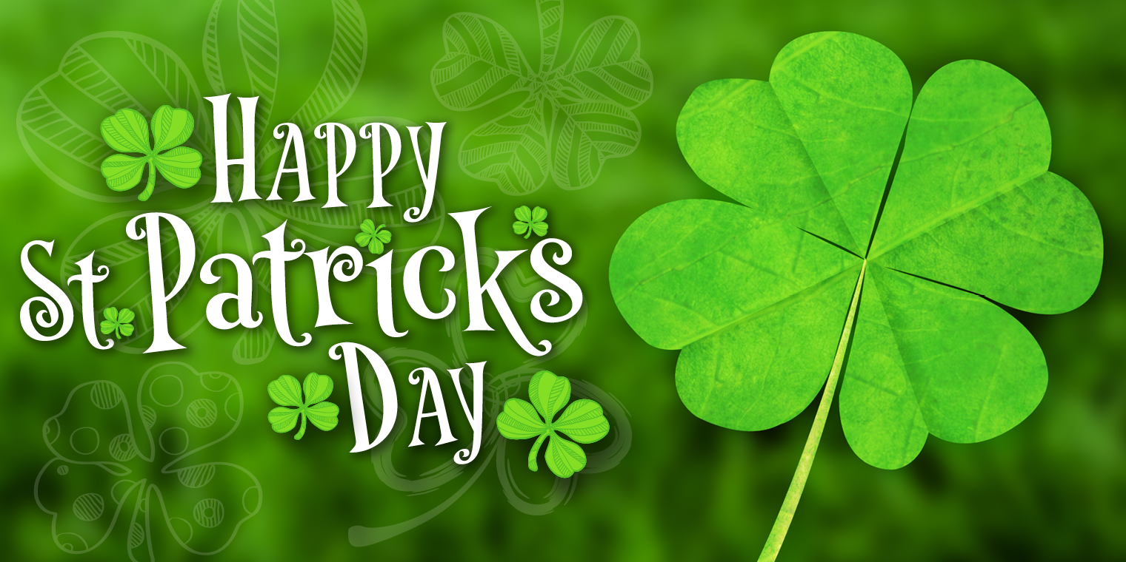

Slide 2
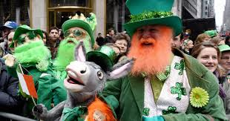
Dzień Świętego Patryka jest dniem wolnym od pracy w Irlandii, Irlandii Północnej, Nowej Fundlandii i Labradorze oraz na Montserrat. Najważniejszą tradycją obchodów dnia św. Patryka jest noszenie ubrań w kolorze zielonym. Zielony to narodowy kolor Irlandii, nawiązujący do trawiastego krajobrazu wyspy i symbolizujący koniczynę przypisywaną tradycyjnie świętemu Patrykowi. Irlandczycy w wielu miastach organizują festyny i uliczne pochody, w których dominuje właśnie zieleń.
Głównym symbolem święta jest shamrock, która jest także jednym z symboli związanych tradycyjnie z Irlandią. Według legendy o św. Patryku, wykorzystał on tę roślinę aby wyjaśniać pierwszym irlandzkim chrześcijanom dogmat o Trójcy Świętej. Nie mogli oni zrozumieć, jak to jest możliwe, że są Trzy Osoby Boskie, a jednocześnie są one jednym Bogiem. Jeszcze inną tradycją związaną z obchodami Dnia św. Patryka jest tradycja picia whiskey – obowiązkową szklankę whiskey zwie się „dzbanem Patryka”. Za tą tradycją stoi legenda, wedle której święty Patryk nastraszył pewną karczmarkę, która nie dolewała pełnej miarki trunku, że przez to pojawią się w jej karczmie potwory. Wystraszona kobieta od tego czasu zawsze napełniała szklankę do pełna. 17 marca jest dniem śmierci św. Patryka, stąd tego dnia co roku wspomina się jego życie i dokonania.

Slide 3
Saint Patrick's Day is a public holiday in the Republic of Ireland, Northern Ireland, the Canadian province of Newfoundland and Labrador (for provincial government employees), and the British Overseas Territory of Montserrat. It is also widely celebrated in the United Kingdom, Canada, United States, Brazil, Argentina, Australia and New Zealand, especially amongst Irish diaspora. Saint Patrick's Day is celebrated in more countries than any other national festival. Modern celebrations have been greatly influenced by those of the Irish diaspora, particularly those that developed in North America. However, there has been criticism of Saint Patrick's Day celebrations for having become too commercialized and for fostering negative stereotypes of the Irish people.

Slide 4
Saint Patrick's Day was made an official Christian feast day in the early 17th century and is observed by the Catholic Church, the Anglican Communion (especially the Church of Ireland), the Eastern Orthodox Church, and the Lutheran Church. The day commemorates Saint Patrick and the arrival of Christianity in Ireland, and celebrates the heritage and culture of the Irish in general. Celebrations generally involve public parades and festivals, céilís, and the wearing of green attire or shamrocks. Christians who belong to liturgical denominations also attend church services and historically the Lenten restrictions on eating and drinking alcohol were lifted for the day, which has encouraged and propagated the holiday's tradition of alcohol consumption.

Slide 5
Saint Patrick was a 5th-century Romano-British Christian missionary and bishop in Ireland. Much of what is known about Saint Patrick comes from the Declaration, which was allegedly written by Patrick himself. It is believed that he was born in Roman Britain in the fourth century, into a wealthy Romano-British family. His father was a deacon and his grandfather was a priest in the Christian church. According to the Declaration, at the age of sixteen, he was kidnapped by Irish raiders and taken as a slave to Gaelic Ireland. It says that he spent six years there working as a shepherd and that during this time he "found God". The Declaration says that God told Patrick to flee to the coast, where a ship would be waiting to take him home. After making his way home, Patrick went on to become a priest.

Slide 6
According to tradition, Patrick returned to Ireland to convert the pagan Irish to Christianity. The Declaration says that he spent many years evangelizing in the northern half of Ireland and converted "thousands". Patrick's efforts against the druids were eventually turned into an allegory in which he drove "snakes" out of Ireland, despite the fact that snakes were not known to inhabit the region.

Slide 7
St. Patrick’s Day is celebrated annually on March 17, the anniversary of his death in the fifth century. The Irish have observed this day as a religious holiday for over 1,000 years. On St. Patrick’s Day, which falls during the Christian season of Lent, Irish families would traditionally attend church in the morning and celebrate in the afternoon. Lenten prohibitions against the consumption of meat were waived and people would dance, drink and feast–on the traditional meal of Irish bacon and cabbage.

Slide 8
złoto - gold zielony – green
koniczyna - Clover skarb - treasure przebieranki - dressing up peklowana wołowina - corned beef kapusta - cabbage Baileys Irish Cream cupcakes – babeczki z Bailey’s barmbrack (brack) – irlandzkie ciasto z rodzynkami Beef and Guinness pie – zapiekanka z wołowiną i Guinessem boxty – irlandzkie placki ziemniaczane colcannon – irlandzkie danie z ziemniaków i kapusty Dublin Coddle – danie z bekonem, wieprzowiną i ziemniakami (na zdjęciu) fadge – irlandzki chleb ziemniaczany Irish breakfast – śniadanie z bekonem, kiełbasą, jajkami, irlandzkim chlebem ziemniaczanym, Irish stew – irlandzki gulasz Guinness – Guinness, rodzaj ciemnego, irlandzkiego piwa rarebit – tost z serem Cheddar, musztardą, żółtkiem i sosem Worcestershire a banshee – zjawa a church – kościół emerald green – szmaragdowy zielony a four-leaf clover – czterolistna koniczyna good luck – szczęście harp – harpa holiday – święto Ireland – Irlandia
legend – legenda leprechaun – krasnoludek luck – szczęście lucky – szczęściarz magic – magia magical – magiczny mischievous – psotny a parade – parada a patron – patron pot of gold – garnek złota a rainbow – tęcza a saint – świętySaint Patrick - Święty Patryk
tradition – tradycja
bagpipes – dudy
fiddle – skrzypki

